Slide 1
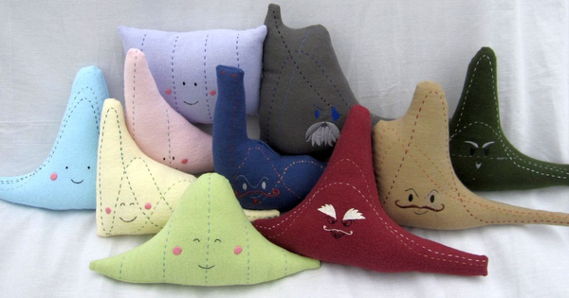
SOEE1475 Statistics and Data Analysis
Lecture 2: Univariate statistics
Graeme T. Lloyd

Slide 2

Today
Defining statistical terms
Introduce ammonite quadrat data set
First statistical test (the t-test)

Slide 3
Variable variables
Variable (computing)
Data storage; can change over as time as program executes
Variable (statistics)
Any characteristic, number, or quantity that can be measured or counted

Slide 4
Variable types
Univariate
A single type of measurement
Bivariate
Two types of measurement
Multivariate
Three or more types of measurement

Slide 5
Data types
Discrete
Ratio scale
Terminate at zero (e.g., mass, Kelvin)
Only integer values (e.g., counts)
Interval scale
Do not terminate at zero (e.g., Celsius)
Continuous
Closed scale
Decimals/fractions possible
Fixed terminals at both ends (e.g., %ages)
Directional
Modular (e.g., compass bearings)
Ordinal scale
Data only have rank order (e.g., Moh’s)

Slide 6
Data types
Discrete
Only integer values (e.g., counts)
Continuous
Decimals/fractions possible
Nominal/Categorical
Names (e.g., Limestone, Basalt)

Slide 7
Example: class heights
Univariate
Continuous
Ratio scale

Slide 8
Populations vs samples
Population
All possible values (may no longer exist, or be accessible)
Sample
A subset of the above and the data we actually have

Slide 9
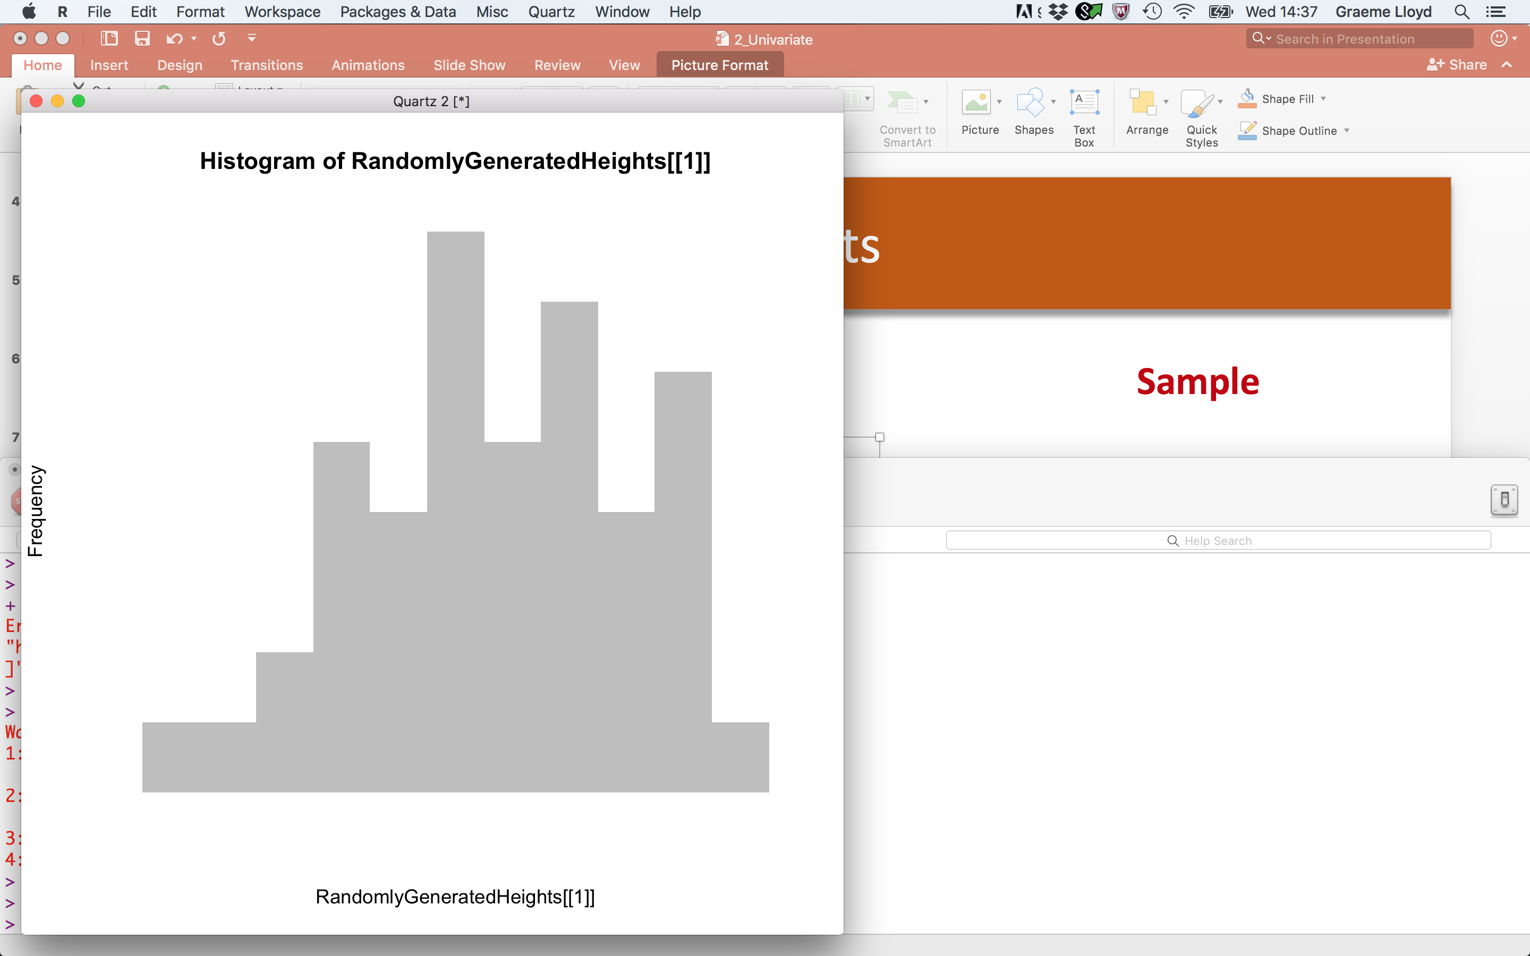
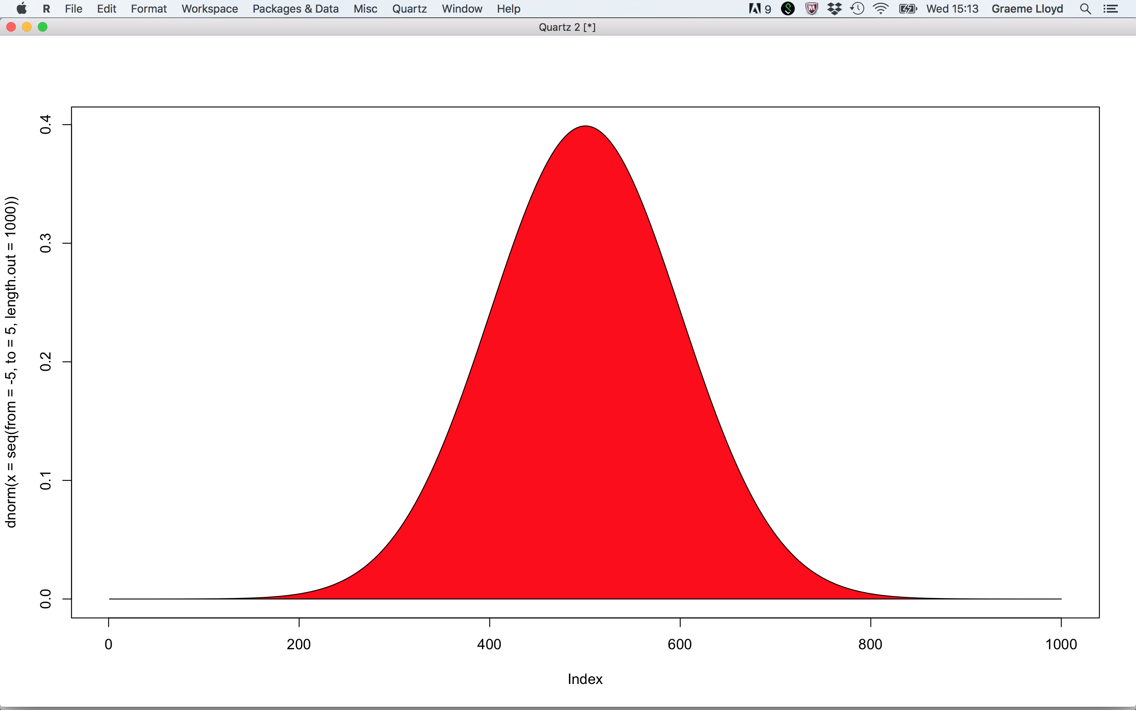
Populations vs samples
Population
Sample
(e.g., all humans ever)
(e.g., the people in this room)

Slide 10
Summarising univariate data
Location
Dispersion
(captures “centre” of distribution)
(captures “spread” of distribution)

Slide 11

Summarising univariate data
Location
Mean
mean(x = ClassHeights)
68.02273
Sum of values / N values
Median
median(x = ClassHeights)
68.25
Middle value
Mode
# See below!
69
Most frequently occurring value(s)
rle(sort(ClassHeights))$values[which(rle(sort(ClassHeights))$lengths == max(rle(sort(ClassHeights))$lengths))]

Slide 12
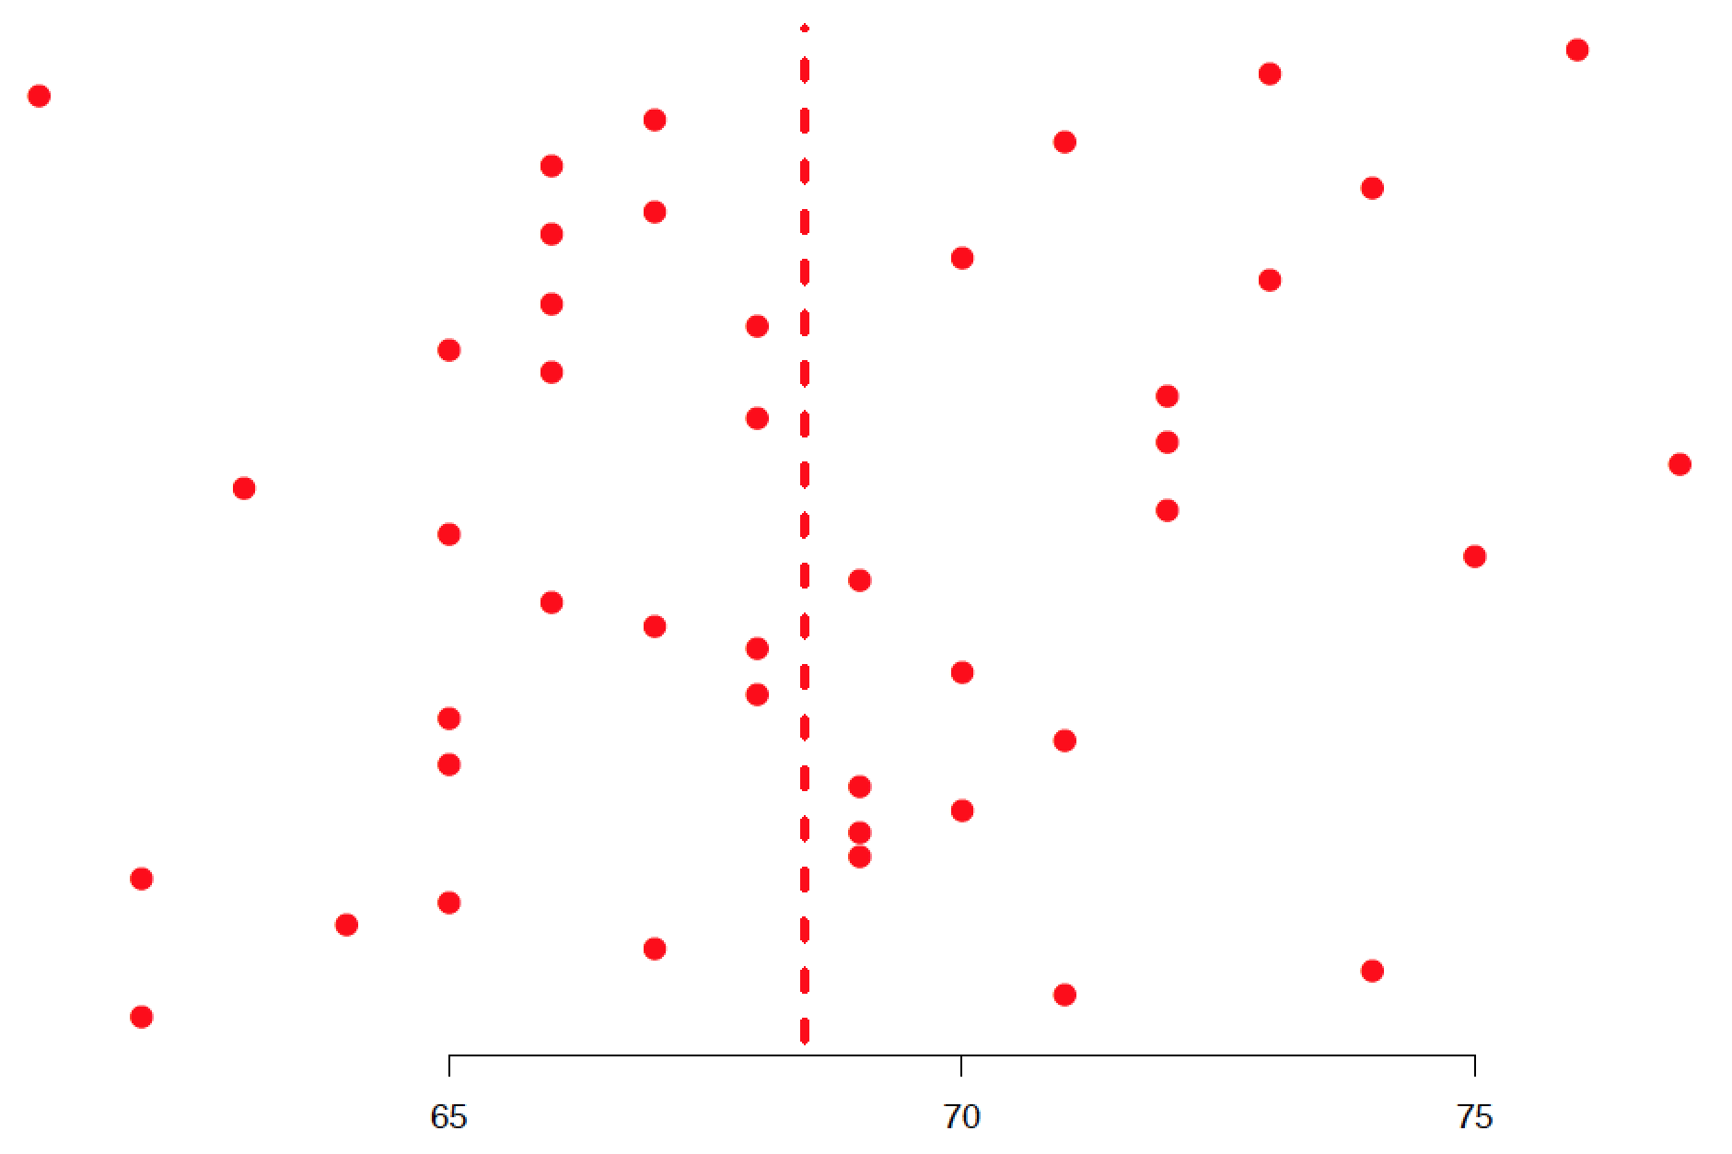
Summarising univariate data
Dispersion
Mean
Variance
Mean squared distance from mean
Height (Inches)

Slide 13
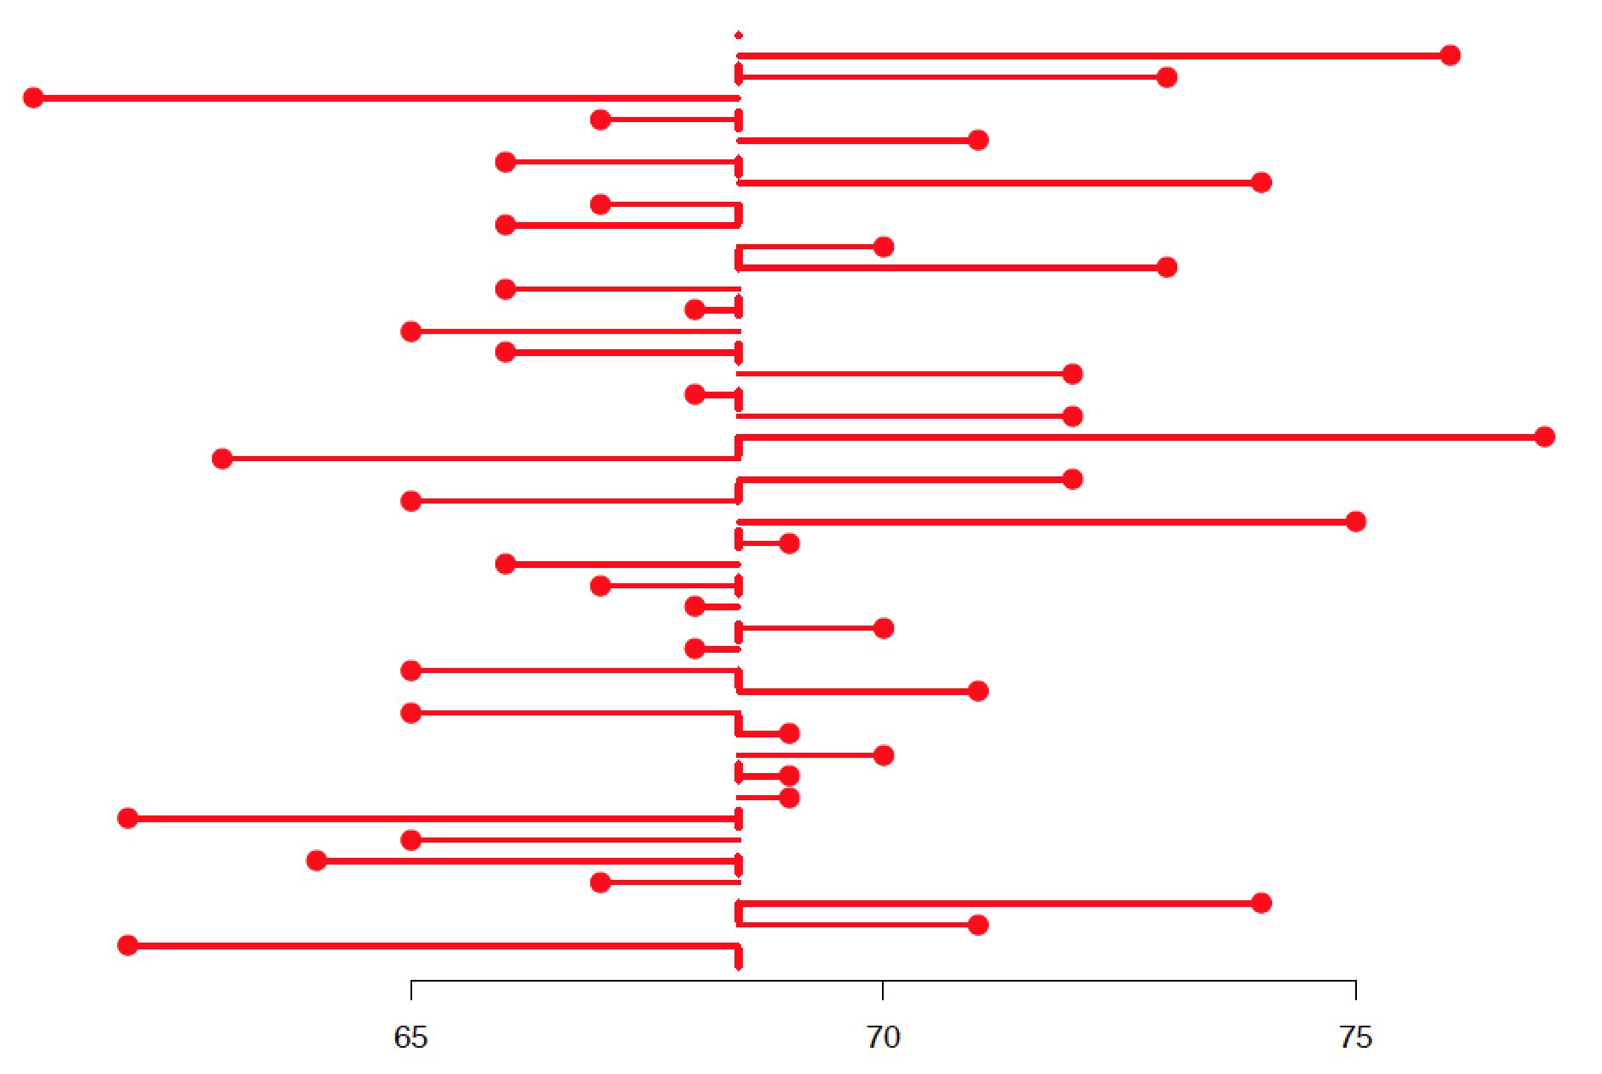
Summarising univariate data
Dispersion
Mean
Variance
Mean squared distance from mean
Height (Inches)

Slide 14
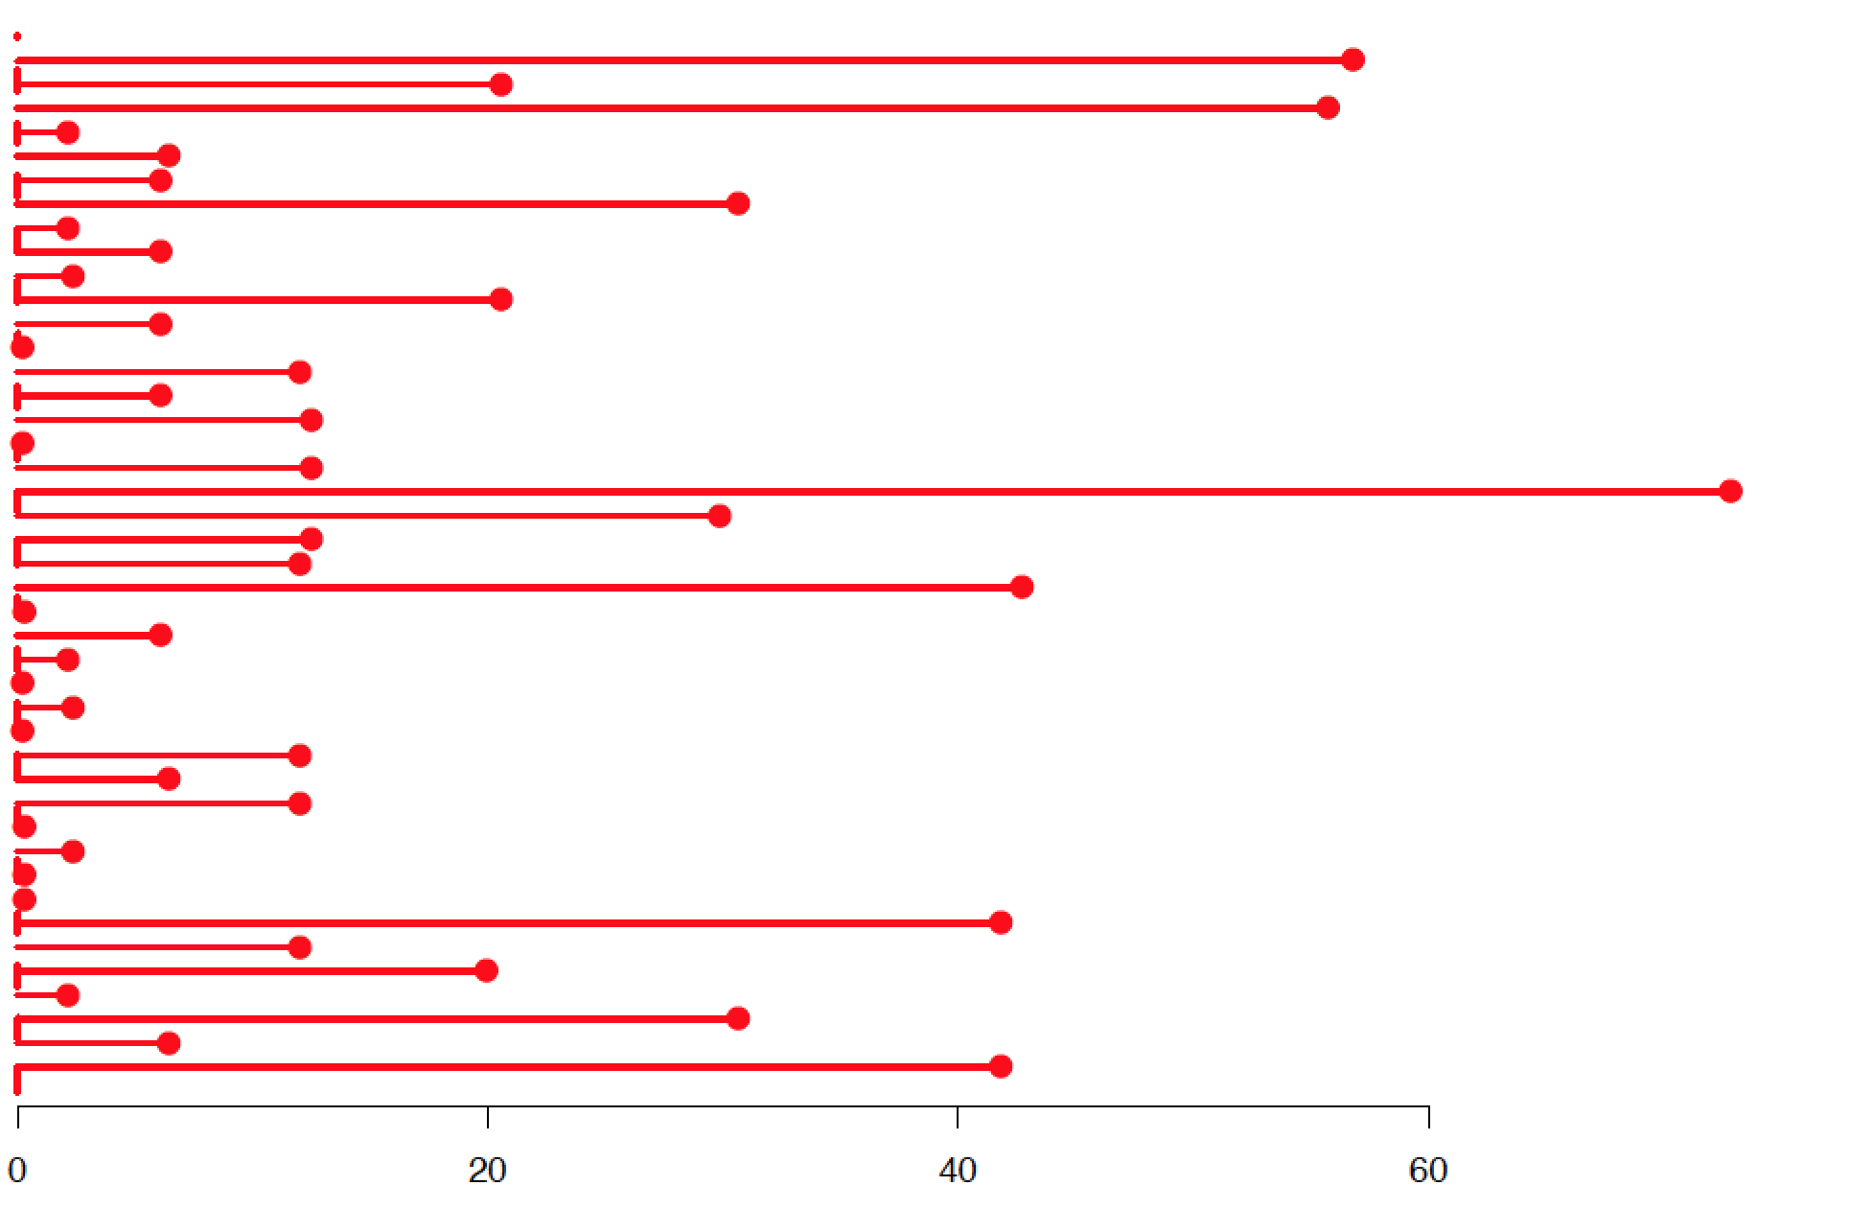
Summarising univariate data
Dispersion
Mean
Variance
Mean squared distance from mean
Height (Inches)

Slide 15
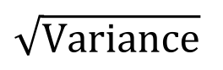
Summarising univariate data
Dispersion
Variance
var(x = ClassHeights)
16.96374
Mean squared distance from mean
Standard deviation
sd(x = ClassHeights)
4.118707
$$\sqrt{Variance}$$
Middle
68.2%
68.02273 ± 4.118707
(Actual: 68.2%)
-1σ
1σ

Slide 16
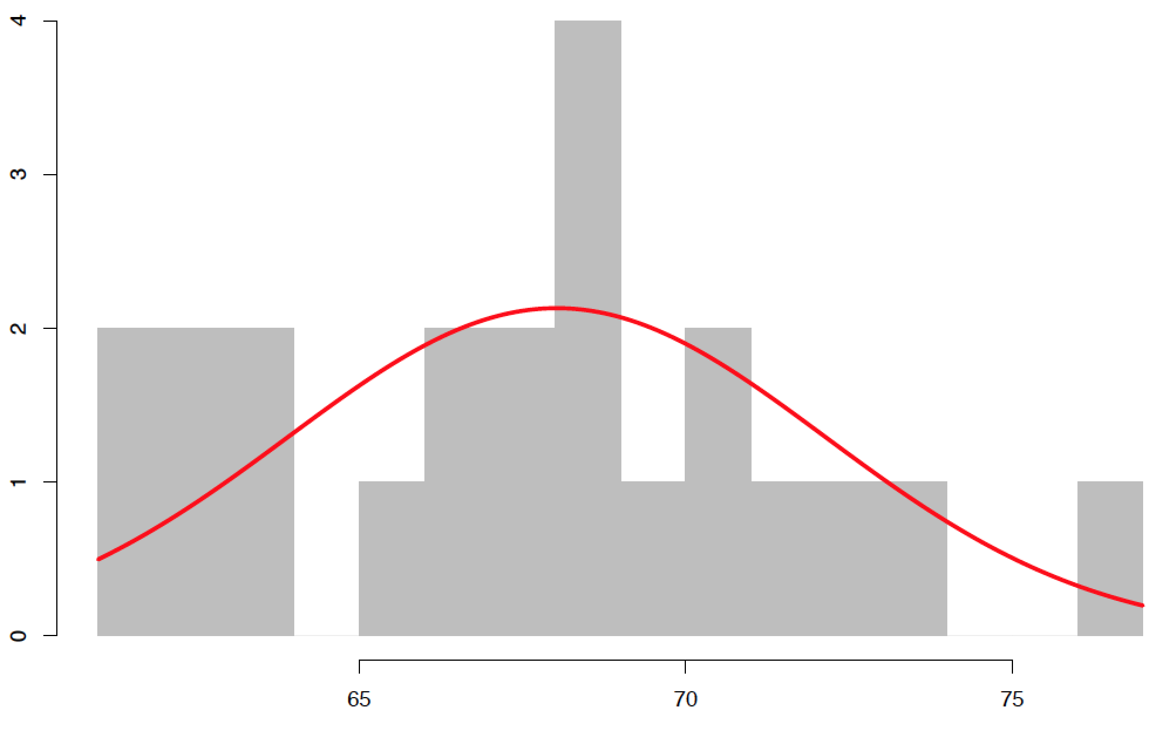
Are class heights normally distributed?
Frequency
Height (Inches)

Slide 17
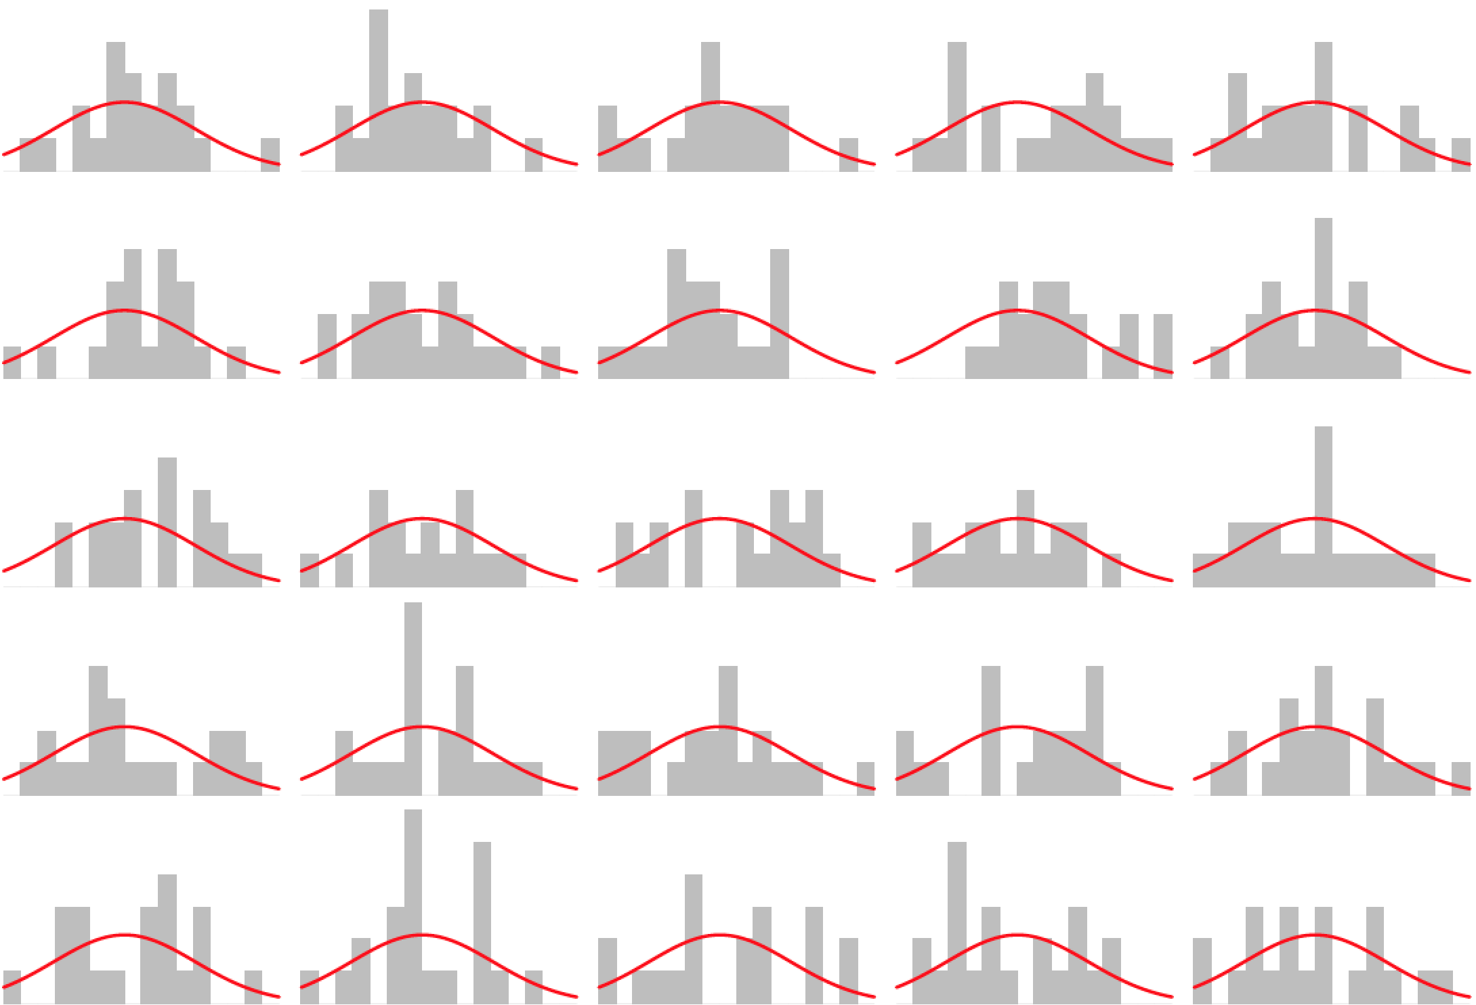
Are class heights normally distributed?

Slide 18
Are class heights normally distributed?
When sample size is small normally distributed data won’t always appear normal

Slide 19

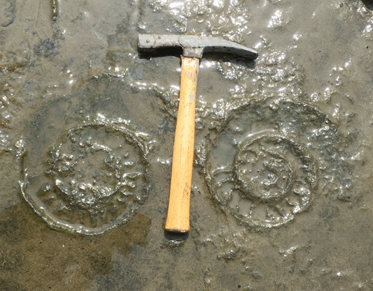
Exercise

Slide 20

Exercise

Slide 21
Exercise
1
2
3
4
5
6
7
8
9
10
A
B
C
D
E
10m
F
G
H
I
J
10m

Slide 22
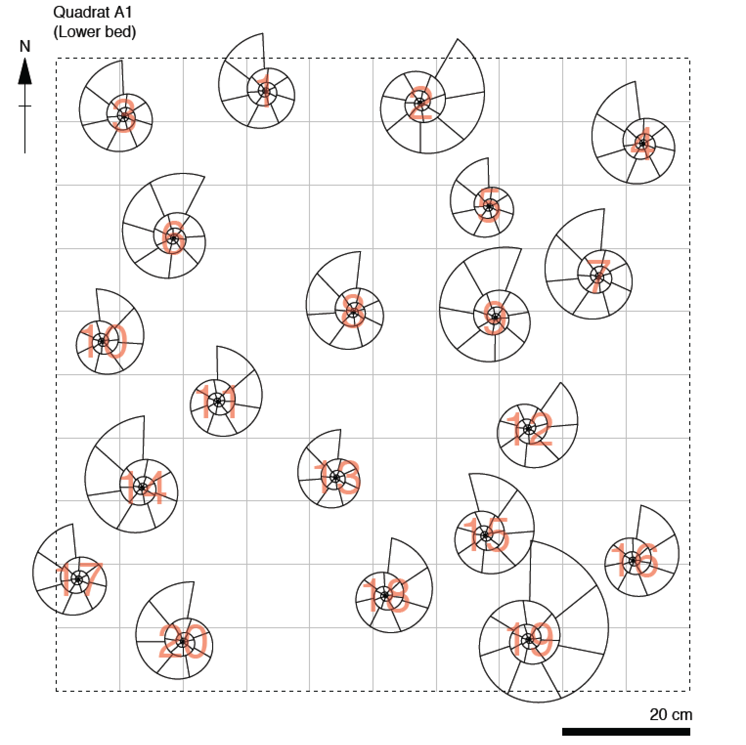
Exercise
1
1
2
3
4
5
6
7
8
9
10
2
3
4
A
B
6
5
C
8
9
7
D
10
E
11
10m
F
12
14
G
13
17
15
16
H
I
18
J
19
20
10m

Slide 23
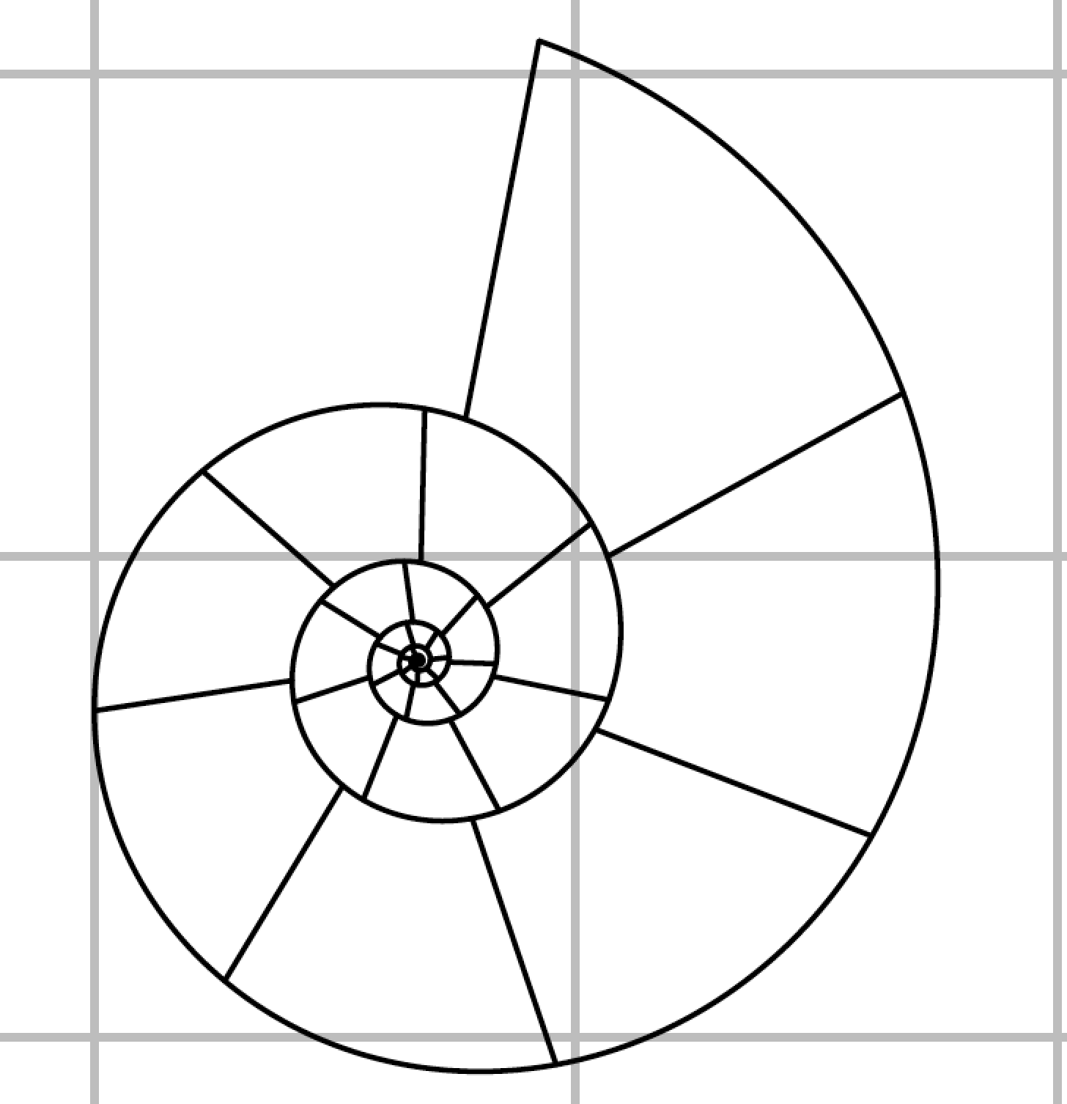
Exercise
Measure ammonites 4 and 17
Units of ruler are mm
Bin your data (for a histogram):
51-75 mm
76-100 mm
101-125 mm
126-150 mm
151-175 mm
176-200 mm
201-225 mm
226-250 mm
251-275 mm
1
2
3
4
5
6
7
1
2
3
8
9
10
4
A
B
6
C
5
9
10
D
8
7
E
11
10m
F
12
13
G
14
17
15
16
H
I
19
J
18
20
10m

Slide 24
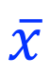
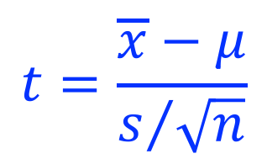
Estimating the population mean
Population
Sample
Current Leeds undergraduates
SOEE1475
μ
$$\overline{x}$$
$$t=\frac{\overline{x}−μ}{s/{\sqrt{n}}}$$

Slide 25
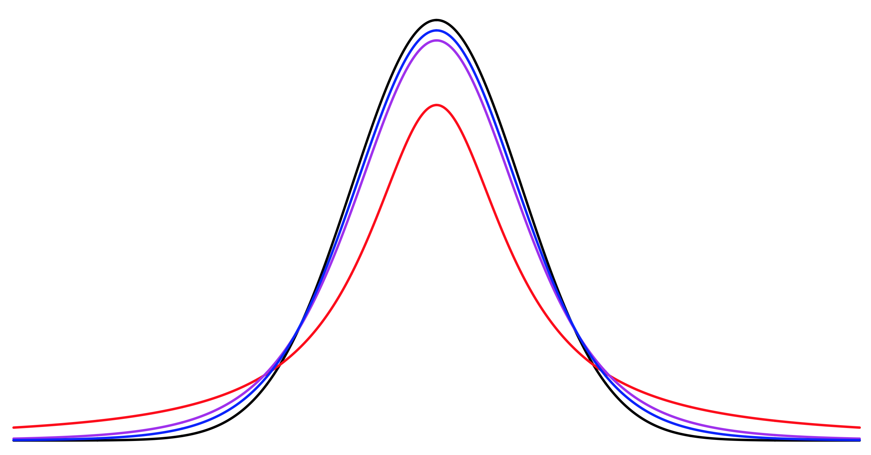
Estimating the population mean
t-distribution (n = 2)
Normal distribution
t-distribution (n = 6)
t-distribution (n = 11)

Slide 26
Estimating the population mean
One sample t-test
Probability a hypothesised population mean (mu) is correct
t.test(ClassHeights, mu = 72)$p.value
0.0001833178
Range of values we can be N% confident population mean falls between
t.test(ClassHeights, conf.level = 0.99)$conf.int[1:2]
65.53648 70.50898

Slide 27
Comparing two samples

Slide 28
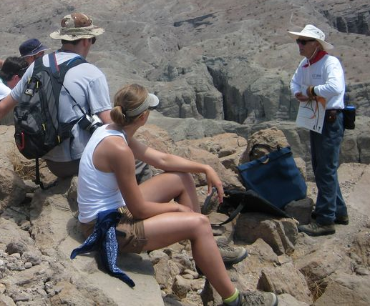
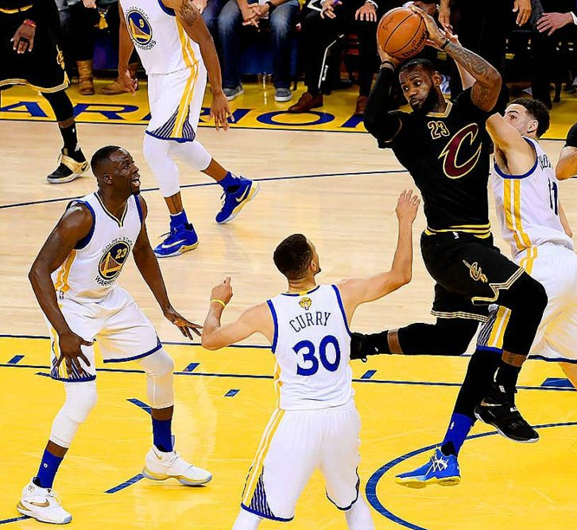


Comparing two samples
SOEE1475

Slide 29
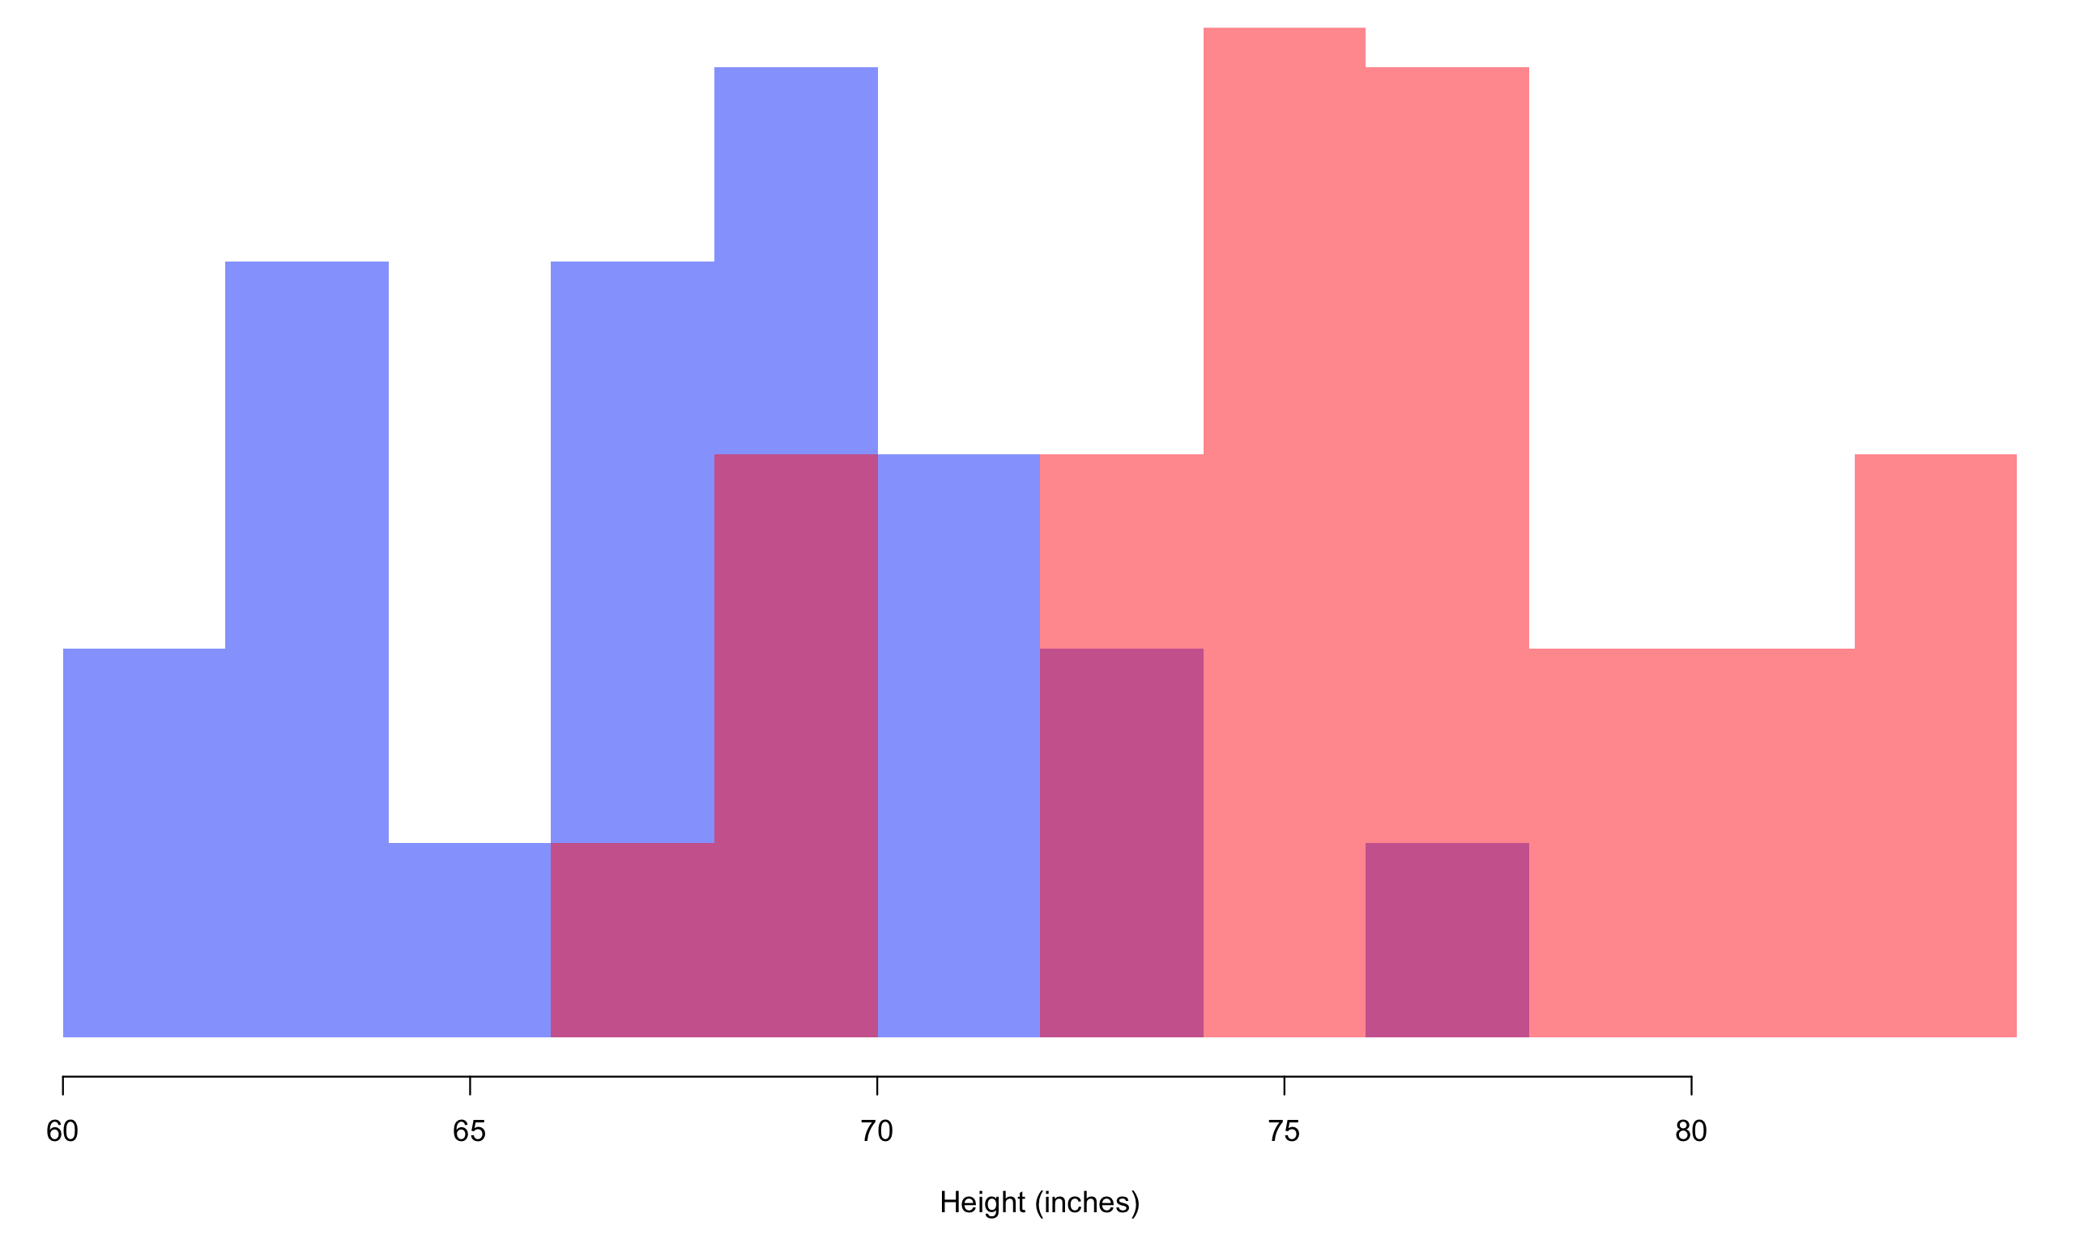
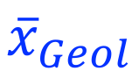
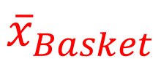
Comparing two samples
SOEE1475
$${\overline{x}}_{Geol}$$
$${\overline{x}}_{Basket}$$
Bulls + Sky

Slide 30
Comparing two samples
Two sample t-test
Probability two samples are drawn from populations with same mean (mu)
t.test(x = GeolHeights, y = BasketHeights)$p.value
7.314495e-09

Slide 31
Lesson #2: data quality
SOEE1475
Chicago
Bulls + Sky

